Slide 1


Maria Kazakova, PhD,
Gaidar Institute for Economic Policy and Russian Presidential Academy of National Economy and Public Administration
Decomposition of Russian GDP growth rates
in 1999-2014
Paris, OECD,
July, 25 2014

Slide 2
Background
Our methodology suggests the decomposition of Russian GDP growth rates into 3 components:
Structural (or potential) component (determined by fundamental growth factors, i.e. capital and labor)
Foreign trade component (due to raw materials’ prices dynamics, approximated by world oil prices)
Cyclical component (includes both business cycles and random shocks, i.e. world economic crisis)
Smoothing methods based on filters (trend method, Hodrick-Prescott filter etc.) have several major drawbacks (i.e. they don’t count for structural relationships in the economy, can be used for large data samples etc.)
Our algorithm is based on production function approach adopted by OECD and used for potential output and output gap estimation, described in Giorno C., Richardson P., Roseveare D. and van der Noord P. (1995) «Estimating Potential Output, Output Gaps and Structural Budget Balances»//Economics Department Working Papers No. 152, OECD (www.oecd.org/dataoecd/2/43/33928808.pdf).

Slide 3
Step 1: Calculation of structural component
Production function method:
Allows for potential output estimation through calculation of labor and capital contribution to economic growth;
Implies a two-factor Cobb-Douglas function (in linearized form) in terms of growth rates for our purposes;
Given actual statistics on capital and labor as well as α and β, we then calculate TFP and smooth it using Hodrick-Prescott filter technique to obtain potential TFP (e*);
We don’t smooth capital input;
We estimate potential labor and finally obtain potential (or structural in our terms) GDP growth rate according to the following formula:
where y* is potential GDP growth rate,
k is capital growth rate (fixed assets adjusted for the level of capacity utilization),
n* is potential labor growth rate calculated according to the OECD methodology,
e* is potential TFP growth rate,
α=0.3, β = 0.7 are previously estimated elastisities of capital and labor, respectively.
We don’t split the economy in 2 sectors (business and government) due to the lack in Russian statistics.

Slide 4
Total factor productivity growth in 1991-2014 (% to previous year)

Slide 5
Potential TFP growth rate in 1991-2014 (% to previous year)

Slide 6
Actual, structural and “residual” GDP growth rates in 1999-2014 (% to previous year)

Slide 7
Step 2: Calculation of foreign trade component of GDP growth rate
Special feature of Russian economy: high level of dependence on energy prices and export dynamics. This feature is not captured by the OECD methodology;
So we modify the OECD methodology by calculating foreign trade component of Russian GDP growth which is dependent on world oil prices dynamics;
Dependence between GDP and oil price levels can be described by the following so called “investment mechanism” within the framework of Solow growth model: improvement of terms of trade (higher oil price level) implies income transfer to the economy (i.e. additional export revenue) which can be invested in capital and thus translates in higher GDP level in long run;
But we also observe transition dynamics between different states of the economy, i.e. different GDP growth levels. This dynamics is can be described by dependence between GDP growth and oil price level;
This (transition) mechanism can be amplified by reaction of economic agents on their income changes due to oil price dynamics similar to Friedman’s permanent income hypothesis.

Slide 8
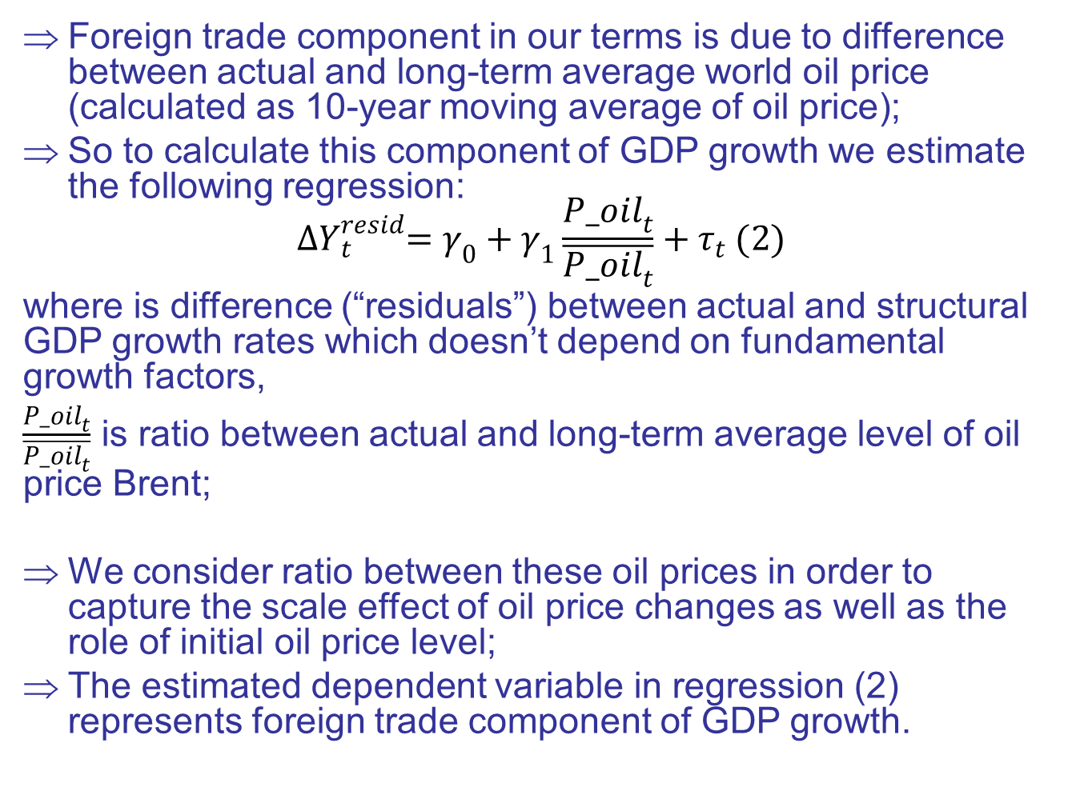
Foreign trade component in our terms is due to difference between actual and long-term average world oil price (calculated as 10-year moving average of oil price);
So to calculate this component of GDP growth we estimate the following regression:
$${∆Y}_{t}^{resid}=γ_{0}+γ_{1}\frac{{P_oil}_{t}}{\overline{{P_oil}_{t}}}+τ_{t} (2)$$
where is difference (“residuals”) between actual and structural GDP growth rates which doesn’t depend on fundamental growth factors,
$\frac{{P_oil}_{t}}{\overline{{P_oil}_{t}}}$ is ratio between actual and long-term average level of oil price Brent;
We consider ratio between these oil prices in order to capture the scale effect of oil price changes as well as the role of initial oil price level;
The estimated dependent variable in regression (2) represents foreign trade component of GDP growth.

Slide 9
Actual GDP growth rate and its 3 components in 1999-2014 (% to previous year)

Slide 10
Step 3: Calculation of cyclical component of GDP growth rate
Cyclical component in our methodology is the sum of business-cycles and random shocks;
It is calculated on the residual basis, i.e. can be considered as residuals obtained after regression (2) estimation
In other words cyclical component equals actual GDP growth minus it’s structural and foreign trade components

Slide 11
Cyclical GDP growth rate in 1999-2014 (% to previous year)

Slide 12
Output gap in 1999-2014 (%)

Slide 13
Discussion of results
Structural component evolves from 4,8% in 1999 to 1,8% in 2014 due to recovery growth and TFP growth after financial crisis in 1998, capacity utilization and investment dynamics and stagnation;
Foreign trade component evolves from 0,4% in 1999 to 2,7% in 2008 and then it falls to 0,9% in 2014;
Cyclical component is volatile and is due to ruble devaluation effect and growth factors’ and investment fluctuations, economic overheating, crisis and stagnation.

Slide 14
Questions
Quality of statistics, mainly regarding capital (in Russia it is one of the main problems; official fixed assets estimate is highly overestimated, adjustments are questionable);
What is the base year for output gap calculation;
Output gap calculation and interpretation (output gap in Russia based on actual and structural GDP numbers is positive after 2009 crisis whereas in OECD countries it’s not the case. This is probably due to oil prices contribution).

Slide 15
THANK YOU FOR YOUR ATTENTION!

