Slide 1

Notes:
58% of Nigerian pentecostals and 45% of South African pentecostals say the government should take steps to make their nation a Christian nation
In South Korea, for instance, only 16% of pentecostals and 10% of charismatics say they favor U.S.-led efforts to fight terrorism.

Slide 2
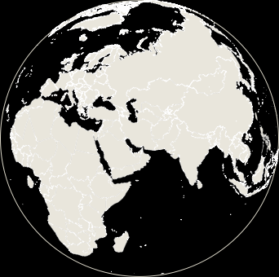
How do we measure Affiliation?

Slide 3


Slide 4
How do we measure Freedom?

Slide 5







Notes:
But religious freedom is very difficult to measure because, how can you measure how much freedom someone has? So – as a social scientist – I look at the inverse: [CLICK] RESTRICTIONS on religion that come both from [CLICK] governments and from [CLICK] groups in society. [CLICK]

Slide 6
How do we measure Attitudes?

Slide 7




Slide 8
Demographics of Religion
Notes:
58% of Nigerian pentecostals and 45% of South African pentecostals say the government should take steps to make their nation a Christian nation
In South Korea, for instance, only 16% of pentecostals and 10% of charismatics say they favor U.S.-led efforts to fight terrorism.

Slide 9
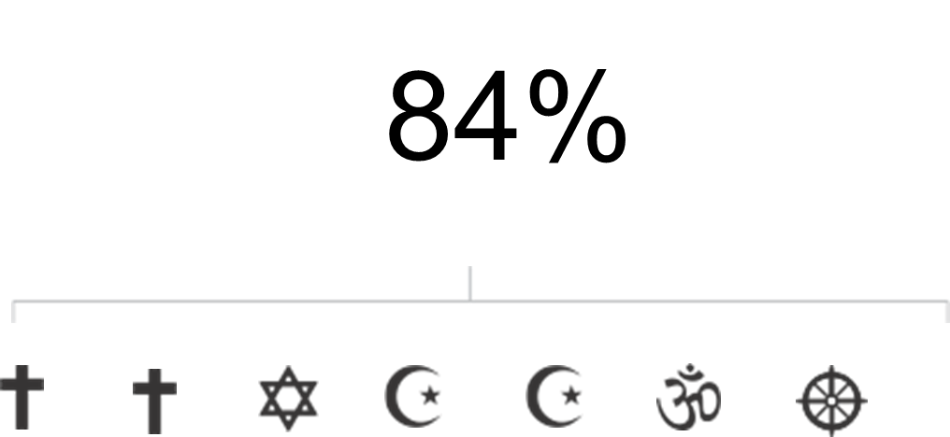
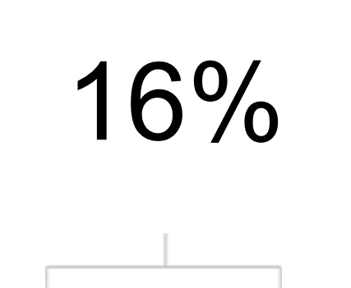


Notes:
We live in a world where [CLICK] more than eight-in-ten people follow a religion. And many of the rest have some religious beliefs or engage in some religious practices. Given that most people have some attachment to religion, it’s important to look at HOW FREE people are to make personal decisions about religion, changing religion, or having no religion at all.. [CLICK]

Slide 10
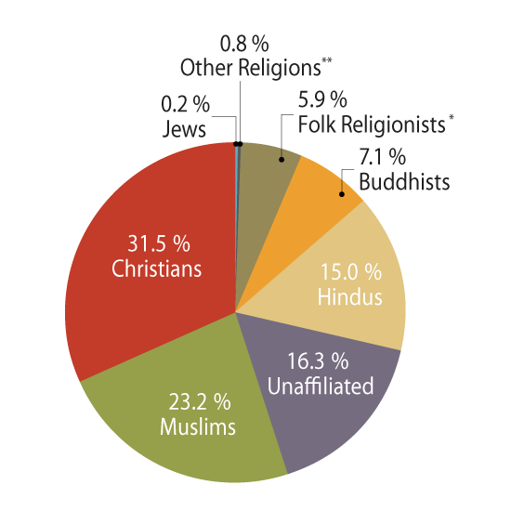
Size of Major Religious Groups

Slide 11
Median Age of Religious Groups
Jews
Buddhists
Unaffiliated
Folk Religionists
Other Religions
Christians
Global
Hindus
28
Global Median Age
Muslims
Notes:
http://www.pewforum.org/2012/12/18/global-religious-landscape-exec/

Slide 12
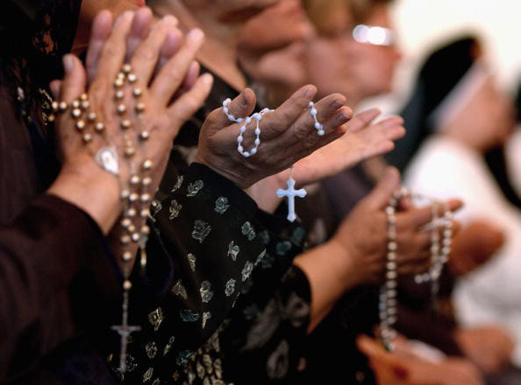
Christians 2.2 billion
74%
Outside of Europe
50%
Catholic
48%
in ten countries
Notes:
http://www.pewforum.org/2012/12/18/global-religious-landscape-exec/

Slide 13
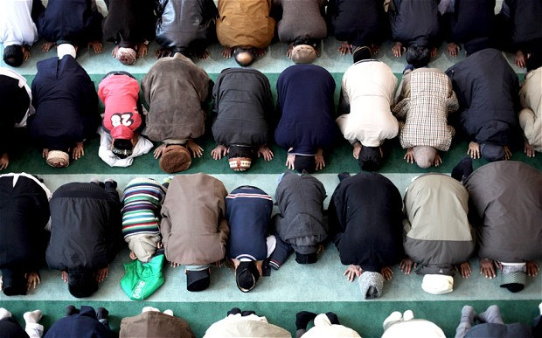
Muslims 1.6 billion
80%
Outside MENA
87-90%
Sunni
66%
in ten countries
Notes:
http://www.pewforum.org/2012/12/18/global-religious-landscape-exec/

Slide 14
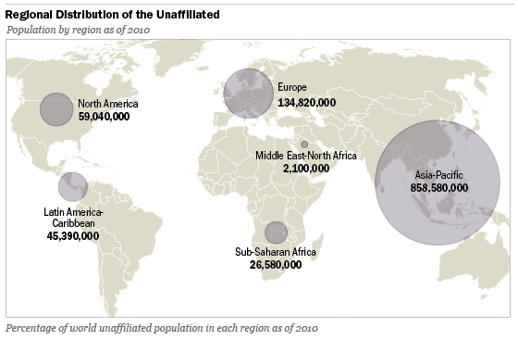
Unaffiliated 1.1 billion
76%
in Asia
7 to 68%
believe in God
62%
live in China
Notes:
http://www.pewforum.org/2012/12/18/global-religious-landscape-exec/
The highest levels of social hostilities in 2011 – the most recent year we’ve studied – were found in Pakistan and India. For instance, in Pakistan there was an increase in violent attacks and intimidation against religious minorities, including violence directed at minority Shia Muslims. In India, Hindu extremists increased violent attacks on Christians in parts of the country.
We look at 13 different measures of social hostilities to create a Social Hostilities Index. This includes acts of religious hostility by private individuals, organizations and social groups. It covers mob or sectarian violence, harassment over religious attire and other religion-related intimidation or abuse.

Slide 15
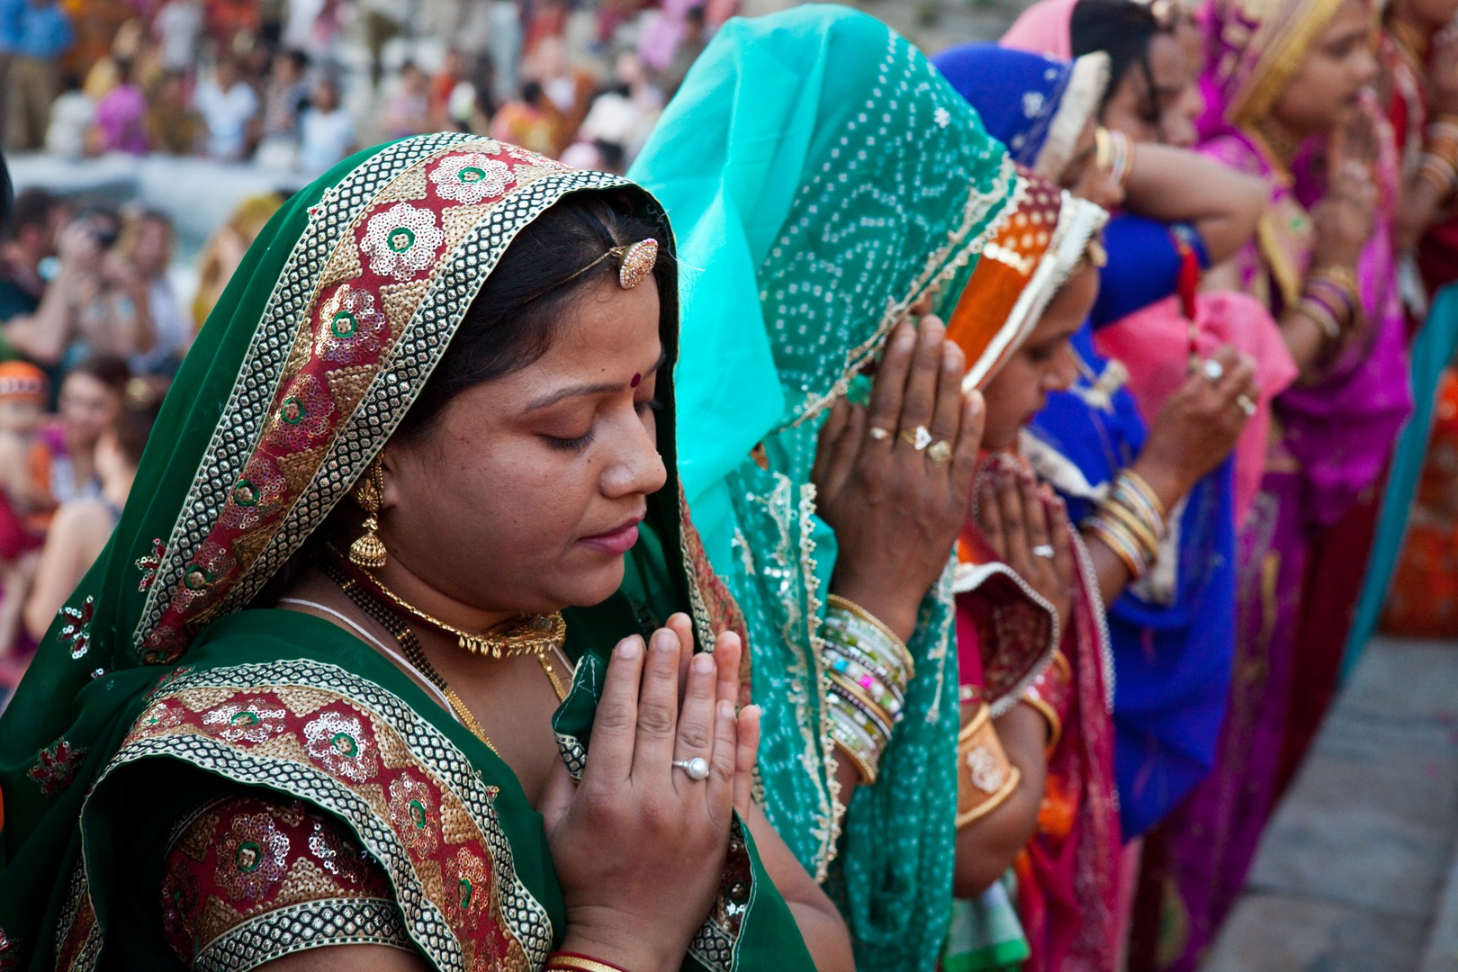
Hindus 1 billion
>99%
live in Asia
25%
of Asia-Pacific
94%
live in India
Notes:
http://www.pewforum.org/2012/12/18/global-religious-landscape-exec/

Slide 16
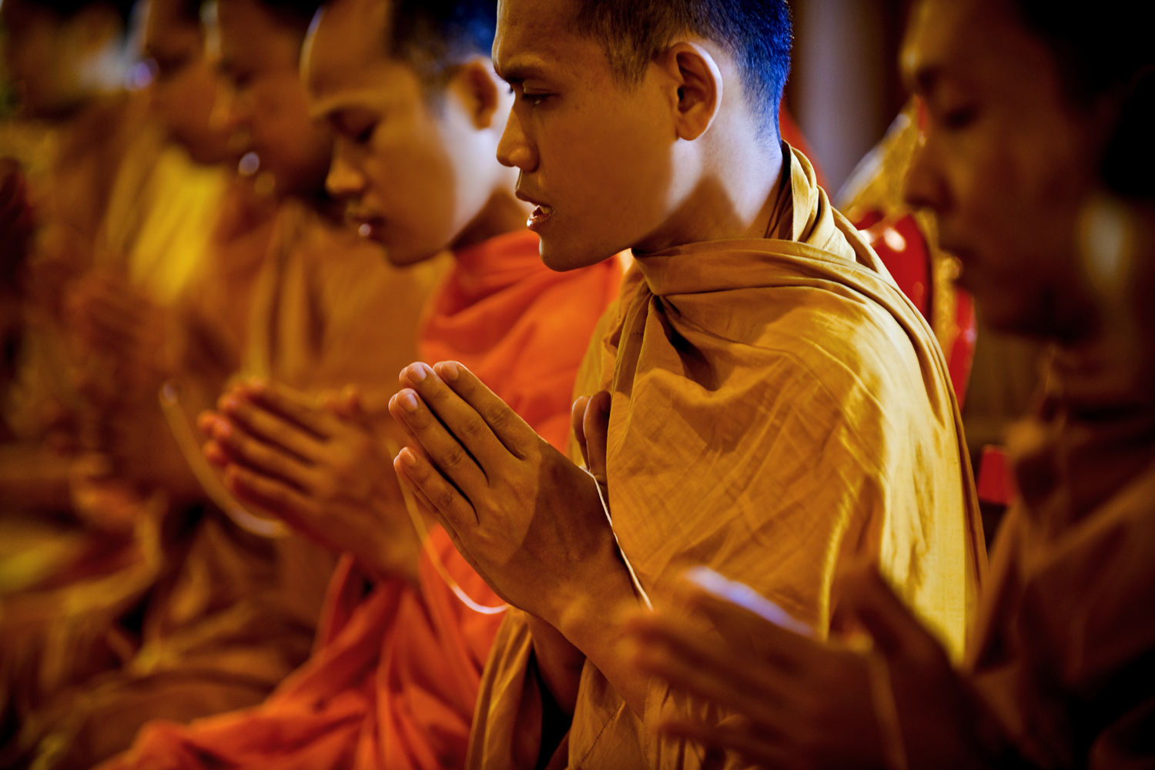
Buddhists 488 million
99%
live in Asia
12%
Of Asia-Pacific
50%
live in China
Notes:
http://www.pewforum.org/2012/12/18/global-religious-landscape-exec/

Slide 17
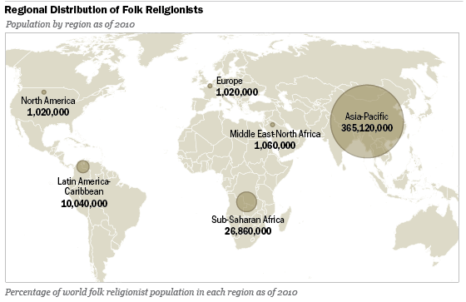
Folk religionists 405 million
90%
live in Asia
9%
Of Asia-Pacific
73%
live in China
Notes:
http://www.pewforum.org/2012/12/18/global-religious-landscape-exec/

Slide 18
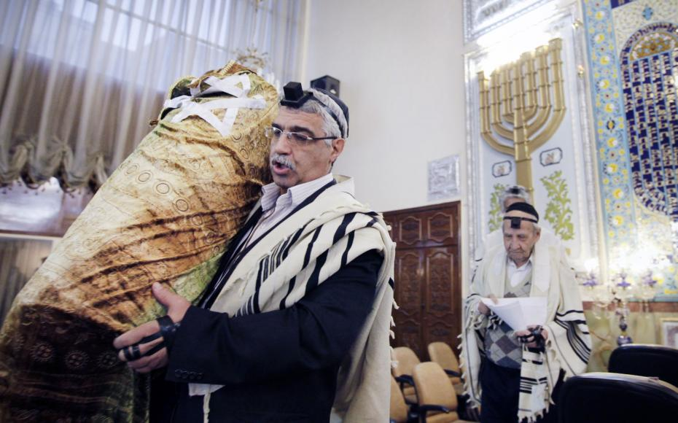
Jews 14 million
10%
live in
Europe
#5
UK Jewish pop
82%
live in U.S.
and Israel
Notes:
http://www.pewforum.org/2012/12/18/global-religious-landscape-exec/

Slide 19
Surveys on Religion
Notes:
58% of Nigerian pentecostals and 45% of South African pentecostals say the government should take steps to make their nation a Christian nation
In South Korea, for instance, only 16% of pentecostals and 10% of charismatics say they favor U.S.-led efforts to fight terrorism.

Slide 21
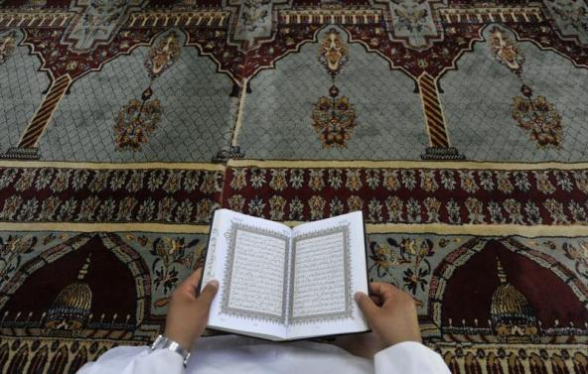
The World’s Muslims
Religion, Politics and Society
79%
in SE Asia say religious leaders should have influence over political matters
78%
Of Muslims in Indonesia say
they are worried about
religious extremism
74%
Of Egyptian Muslims favor making sharia the law for both Muslims and non-Muslims
Notes:
58% of Nigerian pentecostals and 45% of South African pentecostals say the government should take steps to make their nation a Christian nation
In South Korea, for instance, only 16% of pentecostals and 10% of charismatics say they favor U.S.-led efforts to fight terrorism.

Slide 22
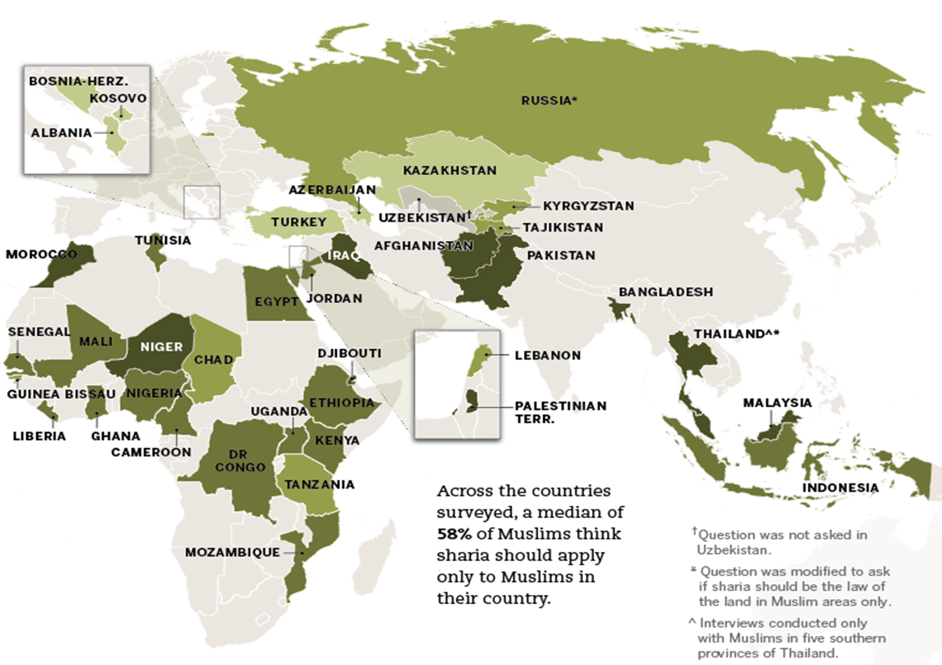
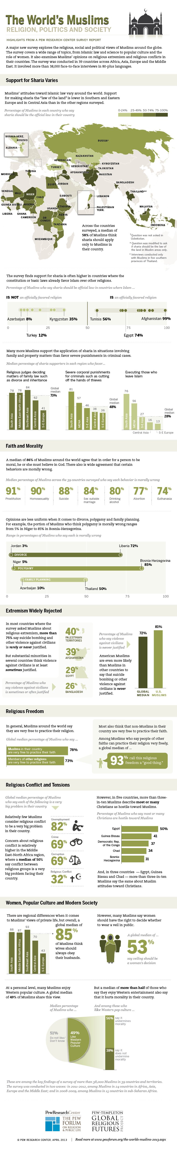
Support Among Muslims For Sharia Law Varies
Notes:
58% of Nigerian pentecostals and 45% of South African pentecostals say the government should take steps to make their nation a Christian nation
In South Korea, for instance, only 16% of pentecostals and 10% of charismatics say they favor U.S.-led efforts to fight terrorism.

Slide 23
Restrictions on Religion
Notes:
58% of Nigerian pentecostals and 45% of South African pentecostals say the government should take steps to make their nation a Christian nation
In South Korea, for instance, only 16% of pentecostals and 10% of charismatics say they favor U.S.-led efforts to fight terrorism.

Slide 24

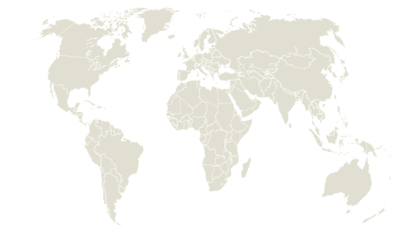
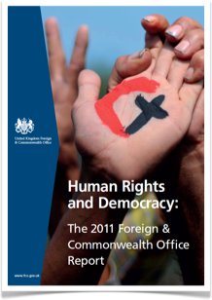
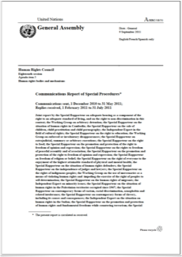
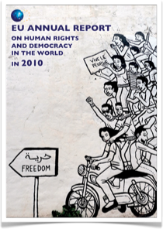
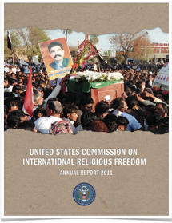
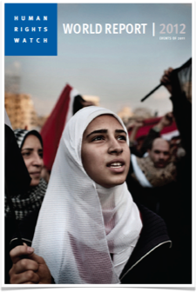
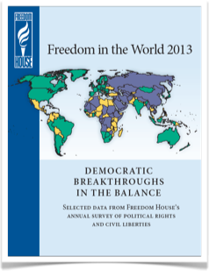
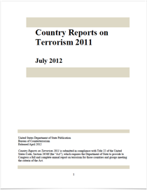
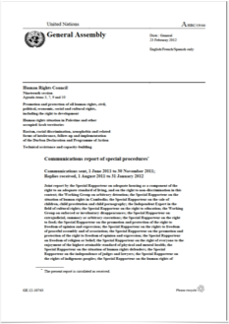
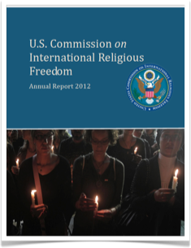
198 Countries & Territories
Notes:
These findings are based on a comprehensive analysis of religious restrictions in 198 countries and territories. [CLICK]
Each year since 2006, my team has carefully studied constitutions and laws as well as human rights reports for EACH of these countries from major international sources [CLICK] – such as the United Nations, Amnesty International, Human Rights Watch, the European Union and the U.S. State Department. Based on these sources, we count up and categorize each reported [CLICK]...

Slide 25




Notes:
Based on these sources, we count up and categorize each reported government restriction on religion and each reported social hostility involving religion, and use these data to create indexes, which I’ll explain in a moment.
But – there’s one important thing to keep in mind – the study does not place a value judgment on any particular restriction. For instance, a country may ban certain religious groups for security reasons. In our study, the ban counts as a restriction regardless of the reason. Pew Research data is like a thermometer. Our job is to measure, not to diagnose or treat.

Slide 26





Notes:
government restriction on religion and [CLICK] social hostility involving religion, and use these data to create indexes, which I’ll explain in a bit. But first, [CLICK] what do I mean by “government restrictions on religion” and “social hostilities involving religion”? Let me give two examples. [CLICK]

Slide 27

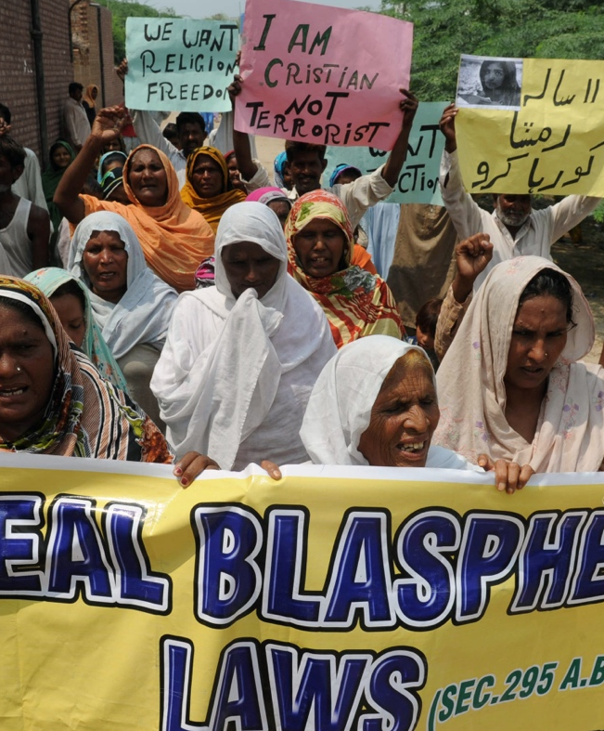
Government Restriction
Notes:
In Pakistan, blasphemy is legally punishable by imprisonment or death – in other words, you can get the death penalty for remarks or actions considered to be critical of God. That’s a [CLICK] GOVERNMENT restriction. [CLICK] But when assassins killed two prominent Pakistani politicians – Shabaz Bhatti and Salman TaSEER – when they spoke out against the blasphemy law, that’s a [CLICK] SOCIAL HOSTILITY involving religion. Another example: [CLICK]

Slide 28
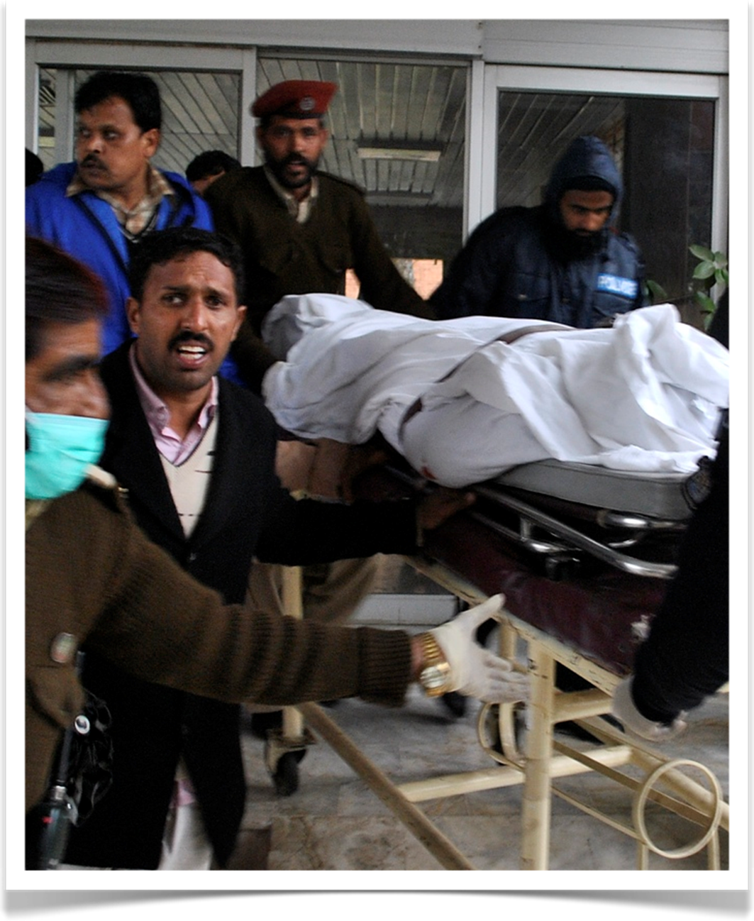
Social Hostility
Notes:
In Pakistan, blasphemy is legally punishable by imprisonment or death – in other words, you can get the death penalty for remarks or actions considered to be critical of God. That’s a [CLICK] GOVERNMENT restriction. [CLICK] But when assassins killed two prominent Pakistani politicians – Shabaz Bhatti and Salman TaSEER – when they spoke out against the blasphemy law, that’s a [CLICK] SOCIAL HOSTILITY involving religion. Another example: [CLICK]

Slide 29

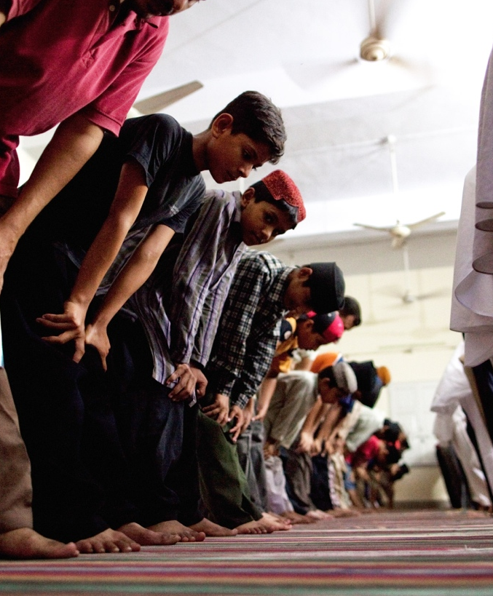
Government Restriction
Notes:
The Indonesian government prohibits Ahmadiyya Muslims from sharing their faith because Ahmadiyyas believe in a prophet after Mohammed – something considered heresy by most Muslims. That’s a [CLICK] GOVERNMENT restriction. [CLICK] But when Indonesian mobs killed Amadiyyas and burned down their mosques, that’s a [CLICK] SOCIAL HOSTILITY involving religion.
So, looking now just at [CLICK] ...

Slide 30
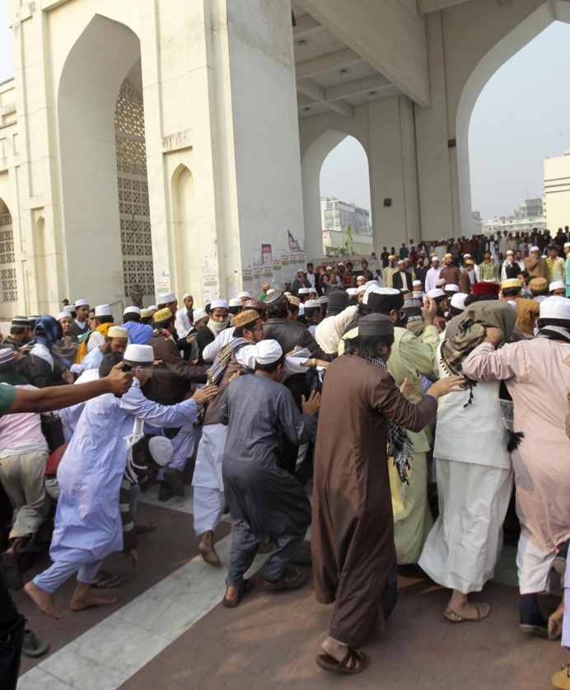
Social Hostility
Notes:
The Indonesian government prohibits Ahmadiyya Muslims from sharing their faith because Ahmadiyyas believe in a prophet after Mohammed – something considered heresy by most Muslims. That’s a [CLICK] GOVERNMENT restriction. [CLICK] But when Indonesian mobs killed Amadiyyas and burned down their mosques, that’s a [CLICK] SOCIAL HOSTILITY involving religion.
So, looking now just at [CLICK] ...

Slide 31

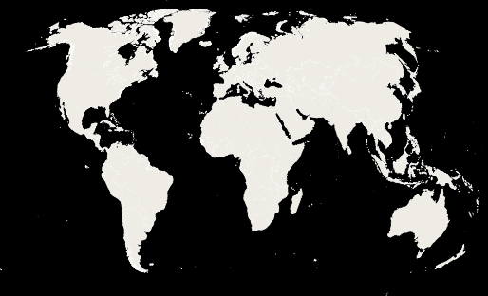


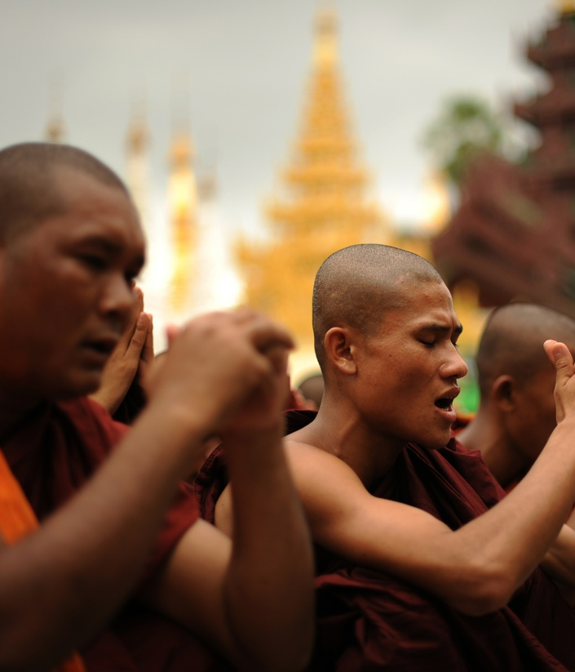
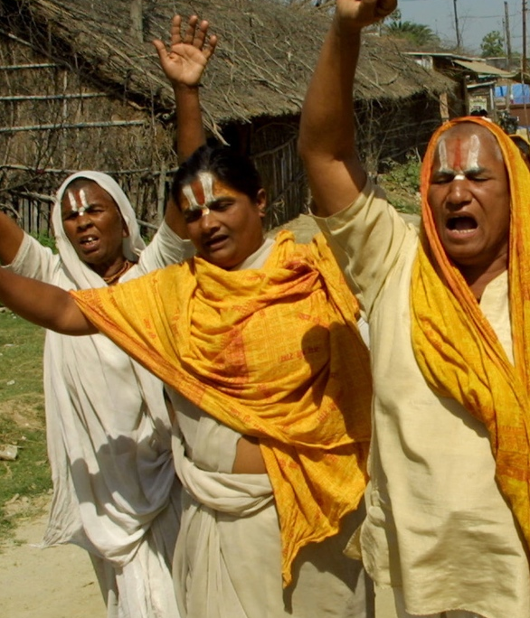
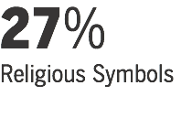
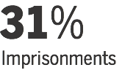
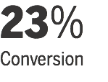
Notes:
government restriction on religion, my study finds that almost two-thirds of people live in countries with high or very high government restrictions, based on 20 different indicators of government policies and actions. Besides those just mentioned, other restrictions include limits on religious symbols, imprisonments and limits on conversion.
The wearing of religious symbols [CLICK] is restricted in more than a quarter of all countries. For instance, the European Court of Human Rights recently found that British law does not adequately protect an employee’s right to display religious symbols in the workplace – such as wearing a crucifix.
Imprisonments [CLICK] occur in nearly a third of all countries. In Burma, for instance, Buddhist monks continue to languish in prison cells for their role as clergy in promoting human rights and democracy.
Conversion [CLICK] is limited in about a quarter of countries. For example, five of India’s 28 states have anti-conversions laws.
Now let’s look at the other broad way religious freedom is restricted – [CLICK]

Slide 32

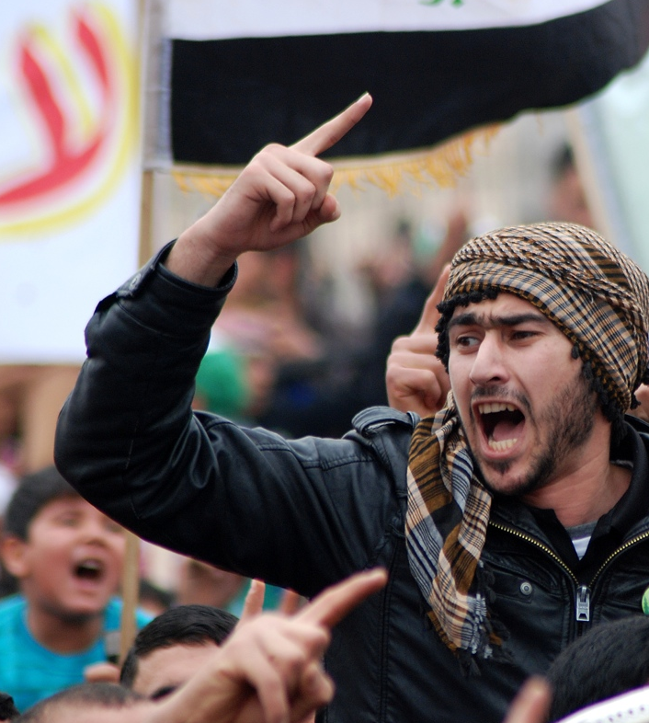



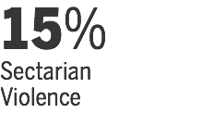
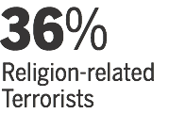
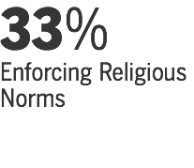
Notes:
social hostilities involving religion. My study finds that [CLICK] half the world’s people live in countries with high or very high social hostilities related to religion, based on 13 different indicators of social hostilities. Besides those just mentioned, other hostilities include sectarian violence, terrorism and the use of violence to enforce religious norms.
[CLICK] SECTARIAN VIOLENCE occurred in more than 1-in-7 countries worldwide. In Iraq, for instance, while violence is down from its peak in 2007, attacks fueled by sectarian and political unrest reportedly continue to occur on an almost daily basis.
[CLICK] Religion-related TERRORISTS were active in more than a third of countries worldwide, including in France, where recently a Jewish Rabbi and several Jewish students were gunned down.
The use of [CLICK] VIOLENCE TO ENFORCE RELIGIOUS norms occurred in a third of countries worldwide. For instance, when Indonesian citizen Alexander An declared his non-belief on an Atheist website, he was attacked by angry mobs who considered his declaration blasphemous.

Slide 33
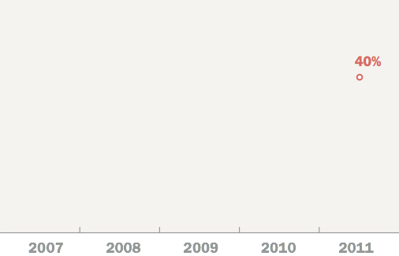
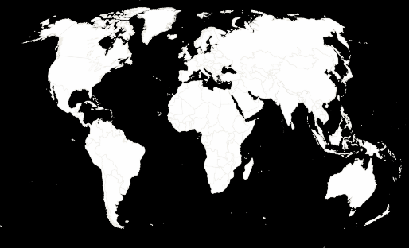
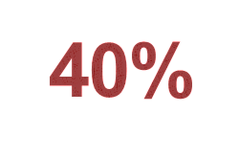

Notes:
One important contribution of this study is that it tracks changes over time.
As I mentioned at the start, [CLICK] 40% of countries have high or very high restrictions on religion – either from government restrictions, social hostilities or both. But the situation just five years earlier was markedly different [CLICK] – then, just 29% of countries had high or very high restrictions.
So, let’s now look at how all 198 countries and territories we studied score on the indexes.

Slide 34


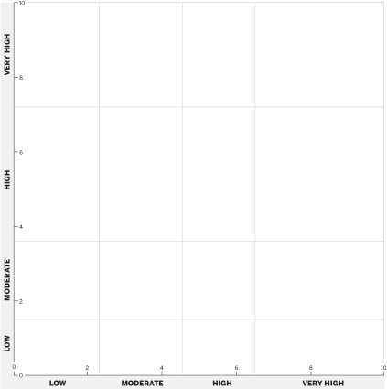





2011
Notes:
In our studies, we divide the world into five major regions so we can look at broad geographic patterns. Looking at the regions, religious restrictions and social hostilities [CLICK] increased in all of them over the five years of the study. [CLICK] But restrictions rose most substantially [CLICK] in the Middle East and North Africa – including through 2011 [CLICK], when the political uprisings known as the Arab Spring occurred.
What contributes to these increases in the Middle East and North Africa? [CLICK]

Slide 35





Notes:
Government favoritism of one religion at the expense of others has the strongest association with social hostilities involving religion.
How does the Middle East and North Africa compare with the rest of the world on this measure? [CLICK] About [CLICK] eight times the share of countries in the region have high or very high government favoritism of religion compared with the rest of the world.

Slide 36




Notes:
Sectarian or communal violence between religious groups has the strongest association with government restrictions on religion.
Again, how does the Middle East and North Africa stack up against the rest of the world on this measure? [CLICK] Sectarian violence is [CLICK] four times more prevalent among the countries in the region than elsewhere in the world. In fact, the number of countries in the region experiencing sectarian or communal violence doubled between 2010 and 2011, the year of the Arab Spring. [CLICK]

Slide 37
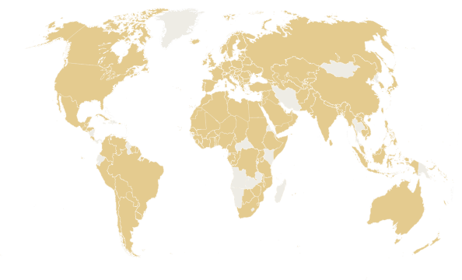

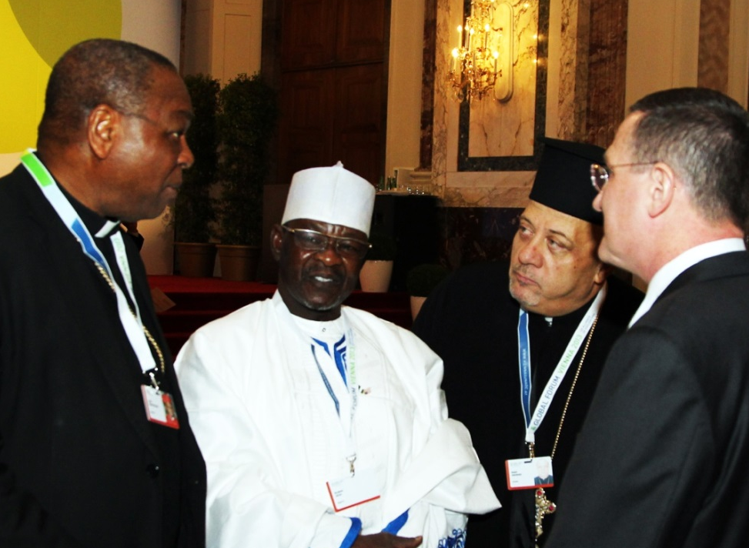
76%
of countries
have initiatives to reduce religious restrictions
Notes:
In 2011 alone, [CLICK] the sources used in our study reported that 76% of countries had government or social initiatives to reduce religious restrictions or hostilities. For instance, Austria recently hosted the UN Alliance of Civilizations, which brought world and religious leaders together to discuss the rising tide of restrictions on religion. This included Cardinal John and Imam Jega of Nigeria, a country beset by many of the social hostilities I’ve described.
Some governments are even brainstorming about ways to use these religious restrictions data to create an early warning system for potential conflict, mass violence and genocide.

Slide 38
Notes:
58% of Nigerian pentecostals and 45% of South African pentecostals say the government should take steps to make their nation a Christian nation
In South Korea, for instance, only 16% of pentecostals and 10% of charismatics say they favor U.S.-led efforts to fight terrorism.

