Slide 1
Demography as if Politics Matters (& Politics as if Demography Matters)
Michael s. teitelbaum
Labor and worklife program
Harvard law school
First International Conference on Political Demography and Macro-social Dynamics
Russian Presidential Academy of National Economy and Public Administration
Moscow
December 13-14, 2013

Slide 2
Two broad questions for discussion
How politically-sensitive is demography?
- and vice versa?
Attention limited? Or excessive? Is understanding growing?

Slide 3
Political demography: defining
study of the size, composition, and distribution of population in relation to both government and politics
political consequences of population change, especially the effects of population change on the demands made upon governments, on the performance of governments, on the distribution of political power within states, and on distribution of national power among states
political determinants of population change, especially political causes of movement of people, relationship of various population configurations to structure & functions of government, and public policies directed at affecting size, composition, and distribution of populations (Myron Weiner, NAS, 1971)

Slide 4
A. Politically-sensitive demography
Demographic forces have been significant politically (both international and domestic)
Low fertility, demographic decline, and “ageing”
High fertility, youth bulges (Africa, Middle East)
International migration and politics
Compositional shifts and politics
Demographic data/projections used for politics
Strategic demography: demography as politics

Slide 5
1. Low fertility, decline, “ageing”
Fears of demographic decline rampant in 1930s
Books: “Twilight of Parenthood”, “Race Suicide”
Active politics: led by Hitler, Stalin, Mussolini, even Myrdals
New pulse of books/videos in English, with alarming titles
The Birth Dearth, 1989 (Ben Wattenberg, AEI)
The Empty Cradle: How Falling Birthrates Threaten World Prosperity and What to Do About It, 2004 (Philip Longman)
What to Expect When No One’s Expecting: America’s Coming Demographic Disaster, 2013 (Jonathan V. Last)
Demographic Winter, 2008 (video Population Research Institute, Washington)
Mostly by journalists, think-tanks, activists
Evocative images, influential in media

Slide 6
“Ageing societies” => national weakness?
“Old men, living in old houses, ruminating about old ideas” (Sauvy, 1950s)
“If current trends continue, some of the great powers of today…will not be the great powers of the future…” “Guns Versus Canes” [Haas, 2012]
But are we being misled by our own measures?
“Old age” definition unchanged since 1930s: 65+
But life expectancy & health @65+ much improved
Need additional measures [Sanderson and Scherbov, 2008]
Example: define by remaining life expectancy (15 yrs)
Adapting to “ageing” possible; political challenge
Adapting to baby booms/busts is more difficult
Notes:
“Aging is not only about the fact that people in a population are, on average, older. It also means that these older people are healthier and have longer remaining life expectancies than their earlier counterparts”
Warren Sanderson and Sergei Scherbov, “Rethinking Age and Aging,” Population Bulletin, 63, 4, December 2008, p. 7.
Japan, Germany, Italy:
e65 rose from 13-15 years in 1950, to 22-23 years in 2005
Old age dependency ratios for More Developed Regions, projected 2005-2045:
Conventional: would rise from 25.1 to 47.0 [ +87%]
Prospective OADR: would rise from 18.2 to 25.7 [ +41%]
ADAPTATIONS:
p. 4: “While population aging is likely to result in a larger fraction of national output being spent on consumption by older persons, this does not pose an insurmountable challenge provided that sensible policies are implemented with enough lead time to allow companies and households to respond. The ultimate national response will likely involve some combination of major structural changes to Social Security, Medicare, and Medicaid, higher savings rates during working years, and longer working lives.”
BABY BOOMS/BUSTS: difficult --- require first adjustments to rising numbers, then reverse adjustments to declining

Slide 7
2. High Fertility & Youth Bulges: political effects
No need to rehearse effects of sustained high fertility
“Youth bulges” = delayed effect of past high fertility
Are bulges politically destabilizing? [Cincotta, 2007, 2008]
If % 15-29 > 40%, poor employment & wages
Disaffected young males: recruitable to strife, violence
=>middle-class support for authoritarian control
Deflating bulge raises support for liberal regimes
Claims not deterministic–tendencies and challenges
Accurate 2007 forecast: Tunisia events 2010-11

Slide 8
3. International Migration & Politics
Major political debates in many countries
Russia (I defer to others here)
Most of EU (UK, Italy, France, Netherlands, Spain, Greece…)
U.S., much of Latin America
Australia (but apparently not Canada)
Migration seen as threat to parties, coalitions
New activist parties in EU states (UK, Greece, Denmark, Netherlands, Italy, others)
Debates about Islam in Europe - emotive neologisms
“Eurabia”, “Islamophobia”

Slide 9
4. Compositional shifts & politics
Intensifies ethnic/religious/racial politics
Can be politically challenging
Drivers: fertility, mortality, and/or migration
Maronites in Lebanon: former majority, now minority
due sustained low fertility + high out-migration
U.S. Hispanics: up due high fertility + high in-migration
Conservative Religious rising due high fertility
Shall the Religious Inherit the Earth? [Kaufmann]
Notes:
Religious: Eric Kaufmann’s challenging book “Shall the Religious Inherit the Earth”
Both international and domestic
International: demographic shifts toward more fundamentalist religious states, e.g. Pakistan, Afghanistan,
Domestic: demographic shifts toward more fundamentalist religious – Mormons, Haredim, Islamists

Slide 10
5. Data/projections for politics
Census data highly political when affects power, resources
Prevent census?: Lebanon, Nigeria, Germany
Manipulate/exclude sensitive categories?: race, religion, ethnicity
Use census data to re-apportion for political advantage
Long-range projections: valuable tool, but also misused
Easy to misunderstand, misrepresent
Projections become “forecasts”, even “recommendations”
“would” becomes “will”
Case study: “Replacement Migration” report, UN, 2000
“The Media Marketplace for Garbled Demography,” Population and Development Review, 30, 2, June 2004.
Notes:
Re: race in US Census:
now some 15 “race” categories, plus more than one race
Also separate question on Hispanic (can be of any race)

Slide 11
6. Strategic demography: demography as politics
Strategy #1: Raise mortality of enemies, out-groups
Sackings, massacres, genocides, expulsions, relocations -- for centuries
20th C. examples: Hitler, Stalin, Turkey, Serbia, Croatia, Rwanda…
Strategy #2: Reduce fertility, selectively
Especially if minorities rising due high fertility
Strategy #3: Nations compete demographically?
Belief that population size and growth = national/military power
Palestinians/Israel (1930s to present)
USSR-Germany: competitive pro-natalism in 1930s
Belief that population growth determines economic growth, but…
High demographic growth with both high & low economic growth
Low demographic growth with both high & low economic growth

Slide 12
Strategic demography (migration)
Strategy #4: international migration as strategy
“Positive” migration stimulated to create/sustain political control
1930s: German Lebensraum; Japanese to China
Marche Verte, Morocco 1975; Han Chinese migration to Tibet
Jewish migration to Israel, West Bank; Palestinian “right of return”
“Negative”- “ethnic cleansing”; mass expulsions
Unraveling of Empires around WW I
Eastern Europe, post WWII: German ethnics to Germany (8 million?)
Kuwait, Saudi Arabia 1991: >400k Palestinians, 750k Yemenis
Bosnia, Kosovo, Rwanda, Myanmar, Vietnam(?)--millions
Notes:
Lebensraum: Germany, Japan
Marche Verte: Morocco and Spanish Sahara, 1975
Tibet: Han migration to Tibet (would be denied)
Israel: encourage Jewish migration (esp Soviet) to Israel
“Right of return”: a dealbreaker -- Palestinian demand of ancestral right of return to territories of Israel

Slide 13
Threat of mass migration as strategic leverage
More common than I thought
“56 attempts to employ…threat of mass migrations as a non-military instrument of influence between 1951 and 2006.” (Greenhill, 2011)
4 visible examples:
North Korea to China
Libya-Italy
Haiti and Cuba to U.S.

Slide 14
Strategic demography via refugee admissions
A popular Cold War policy in the West
Admit as “refugees” to discredit Communism?
NOTE: Assumed USSR & Warsaw Pact would restrain exits (!)
Cubans to U.S.: defined as “refugees”
Cuban Adjustment Act sustained by Cuban-American lobby
West Germany: aussiedler defined as citizens

Slide 15
Does demography challenge state sovereignty?
Is military intervention justified to halt genocide, expulsion?
India-Pakistan war 1971; later NATO military interventions
Do global refugee norms limit state sovereignty?
Yes -- 1951 UN Convention and 1967 Protocol
Is there a basic human right to cross borders to seek work?
Claimed by several Mexican Presidents
UN International Convention on Protection of Rights of All Migrant Workers & Members of their Families (UN General Assembly 1990)
Does demography determine decisions on sovereignty?
"Given the demographics west of the Jordan River, the only way for Israel to endure and thrive as a Jewish and democratic state is through the realization of an independent and viable Palestine." President Obama, Jerusalem, March 21, 2013
Notes:
Convention on Rights of All Migrants:
- Promoted for many years by Mexican Government.
- “self-activating” provision, “enter into force” with 20th ratification
- Did so in 2003
- Some 35 countries have ratified
- However, only migrant sending countries have ratified; no migrant-receiving countries have accepted.
Interesting issue: what is meaning of concept in international law “enter into force.”
Albania, Argentina, Algeria, Azerbaijan, Bangladesh, Belize, Bolivia, Bosnia and Herzegovina, Burkina Faso, Cape Verde, Chile, Colombia, East Timor, Ecuador, Egypt, El Salvador, Ghana, Guatemala, Guyana, Guinea, Honduras, Kyrgyzstan, Lesotho, Libya, Mali, Mauritania, Mexico, Morocco, Nicaragua, Peru, Philippines, Senegal, Seychelles, Sri Lanka, Saint Vincent and the Grenadines, Syria, Tajikistan, Turkey, Uganda and Uruguay.

Slide 16
C. Political demography is not new
But dominated by journalists, pundits
Who seem to pay more attention than warranted
Needed: more attention from
Political scientists
Demographers
Notes:
Mercantilists: population growth increases wealth/power of sovereign; advocated state intervention to increase all of these.
Physiocrats: free-marketeers who saw land resources as wealth and rejected govt controls of mercantilists.
Utopians: embraced the population optimism of mercantilists, but advocated equitable distribution of resources.
Classical economists: decreasing agriculture returns to inputs of both capital and labor, the latter resulting from continuing population growth. Advocated free markets which would regulate population increase.
Malthusians (subset of classical economists): rejected population optimism of utopians but opposed "artificial and unnatural modes of checking population" such as contraception.
Neo-Malthusians: population pessimism of Malthusians, but supported voluntary contraception while opposing abortion.
Marxist-Leninists (traditional): shared population optimism of the mercantilists and utopians, denouncing pessimism of both Malthusians and neo-Malthusians. But joined Malthusians (often unwittingly) in opposition to contraception, while departing from their views by advocating abortion as a basic human right.
The Chinese Marxists (under Mao): ambivalence, but mostly favored population growth. Mao’s successors rejected population optimism of their Marxist-Leninist forebears and embraced strong state intervention to limit fertility via both Malthusian (marriage limits) and neo-Malthusian (contraception/abortion within marriage).
Cornucopians of the New Right: population optimism of the utopians, mercantilists, and traditional Marxist-Leninists, but rejected economic statism of the latter two…
Malthus’ opposition to contraception is a surprise to many who continue to believe that he was a strong proponent. To the contrary, this former Anglican curate considered contraception and some of the other “preventive checks” he discussed to be “immoral vices”.

Slide 17
Some guesses for the next half-century
Caveat emptor: No one can see future… my guesses
Less predictable: needs constant scrutiny/analysis
Mortality: new epidemics? low-probability, but high-impact
Fertility: majority now have control => rates more erratic
Migration: more volatility, more political controversy
Young adults stressed – and they are the reproducers
Scary dystopias continue: Effective political tools
Strategic demography to continue (esp migration?)

Slide 18
Is understanding growing? I think so…
More thoughtful attention by scholars
especially political scientists
Recent excellent books, articles
International Studies Association
new political demography group
RANEPA
Research Laboratory on Political Demography and Social Macrodyamics
directed by one of field’s leaders

Slide 19
If true, what might we hope to see?
Fair, expert assessment of linkages
Understand deep uncertainties, esp mid-to-long term
Need for better measures of key elements
Configure variety of optimal responses to plausible trends
Address potentially large demographic effects of politics
Moderate excessive claims; keep them honest
Aid journalists, politicians: get the facts right
This RANEPA workshop is a good start!

Slide 20
THANK YOU! Comments welcome
Michael teitelbaum
Labor and worklife program
Harvard law school
mst1900@yahoo.com

Slide 21
ADD’L slides

Slide 22
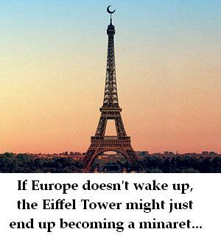
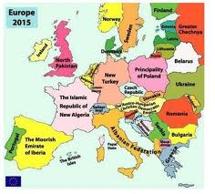
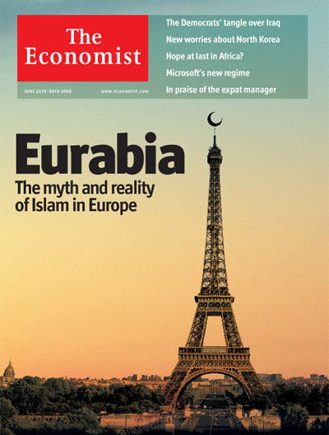
Images of “Eurabia”

Slide 23
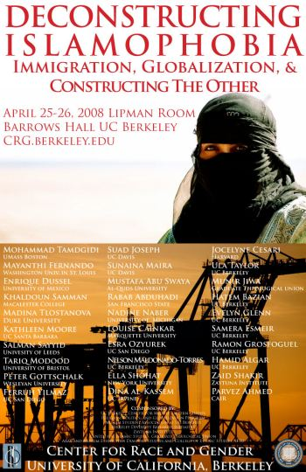
Images of “Islamophobia”

Slide 24
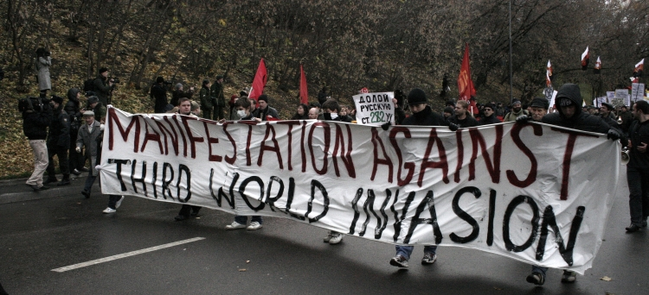
Parallel debates in Russia?
Navalny attacks Putin allies, immigration in Moscow TV debate
By Stuart Williams Agence France Press, August 12, 2013

Slide 25
2007/8 Forecast
“The first (and perhaps most surprising) region that promises a shift to liberal democracy is a cluster along Africa’s Mediterranean coast: Morocco, Algeria, Tunisia, Libya, and Egypt, none of which has experienced liberal democracy in the recent past. The other is in South America: Ecuador, Colombia, and Venezuela, each of which attained liberal democracy demographically “early” but was unable to sustain it. Interpreting these forecasts conservatively, we can expect there will be one, maybe two, in each group that will become stable liberal democracies by 2020.”
Cincotta, R.P. 2008. “How Democracies Grow Up.” Foreign Policy: March/April, 80-82 (plus supplementary map and graph online).
Cincotta, R.P. 2009. “Half a Chance: Youth Bulges and Transitions to Liberal Democracy,” Environmental Change and Security Project Report, 13: 10-18. Available at: http://www.wilsoncenter.org/topics/pubs/ECSPReport13_Cincotta.pdf
These predictions are the subject of the presentation on C-Span: http://www.c-spanvideo.org/richardcincotta

Slide 26
Age bulge scenarios, Cincotta
On North Africa (2010):
“In this scenario, a North African state, probably Tunisia, undergoes a “color revolution”—a swift and non-violent transition to liberal democracy. This may bring Islamists into power—or maybe not. However, the possibilities for spreading democracy through the region and for new political dynamics to play out in an age-structurally maturing Arab state could produce both risks and opportunities for the US.
On Egypt (2011):
“According to the age-structural model, if the ongoing demonstrations in Egypt succeed in ousting the Mubarak regime, the new regime is likely to fall short of liberal democracy, perhaps yielding a partial democracy (partly free), or perhaps an autocracy (not free). If Egypt makes it to a liberal democracy, it has a low chance of staying there for a decade.”

Slide 27
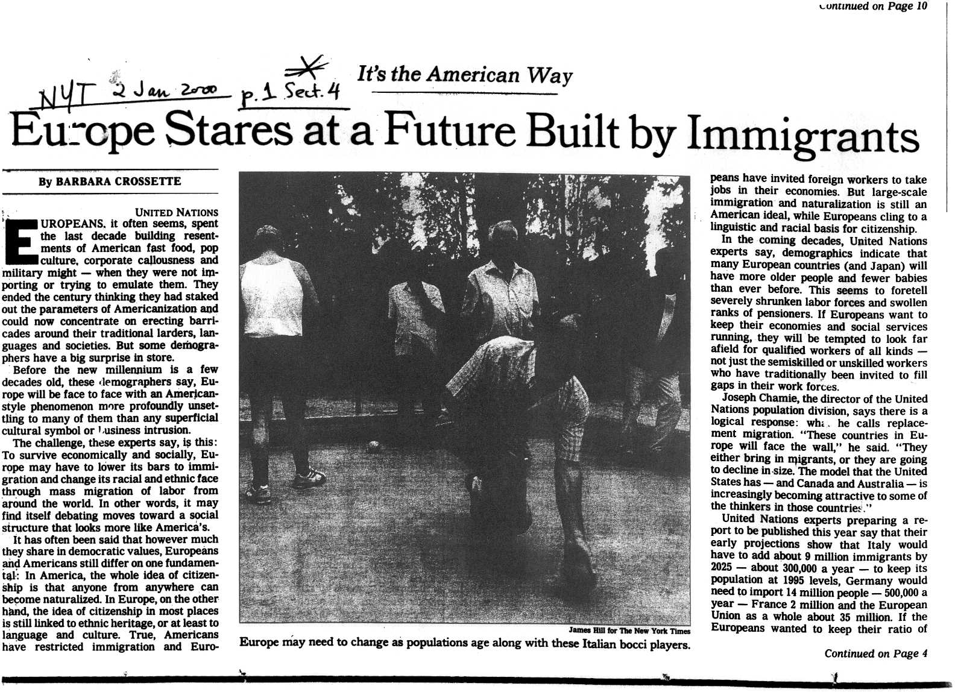

Slide 28
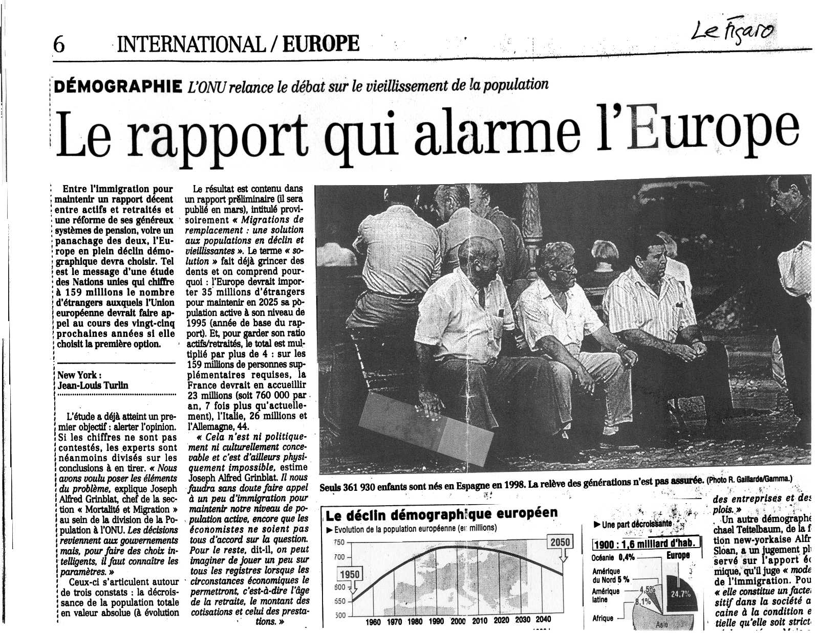

Slide 29
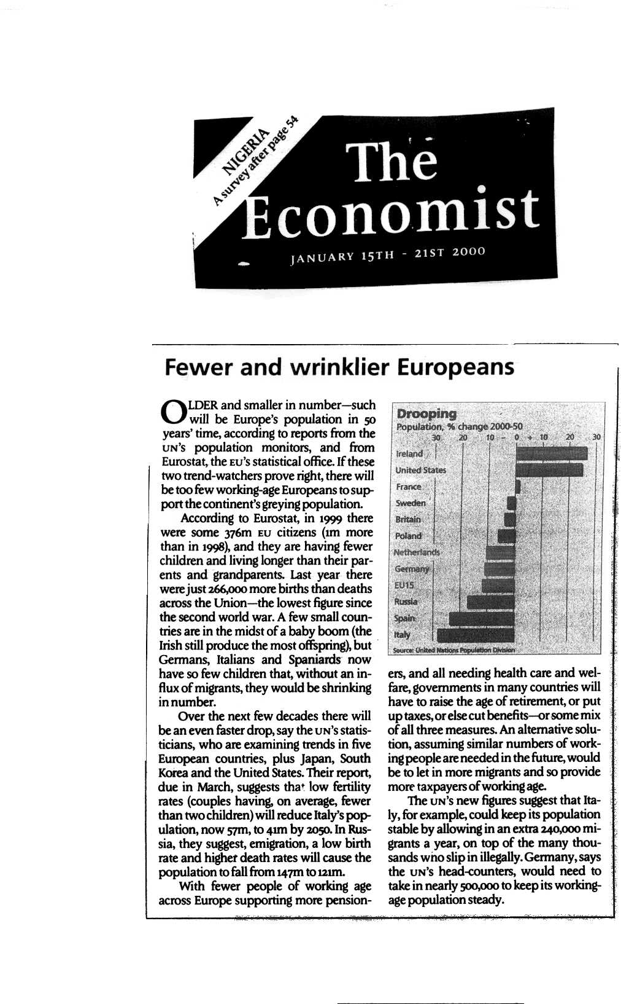

Slide 30
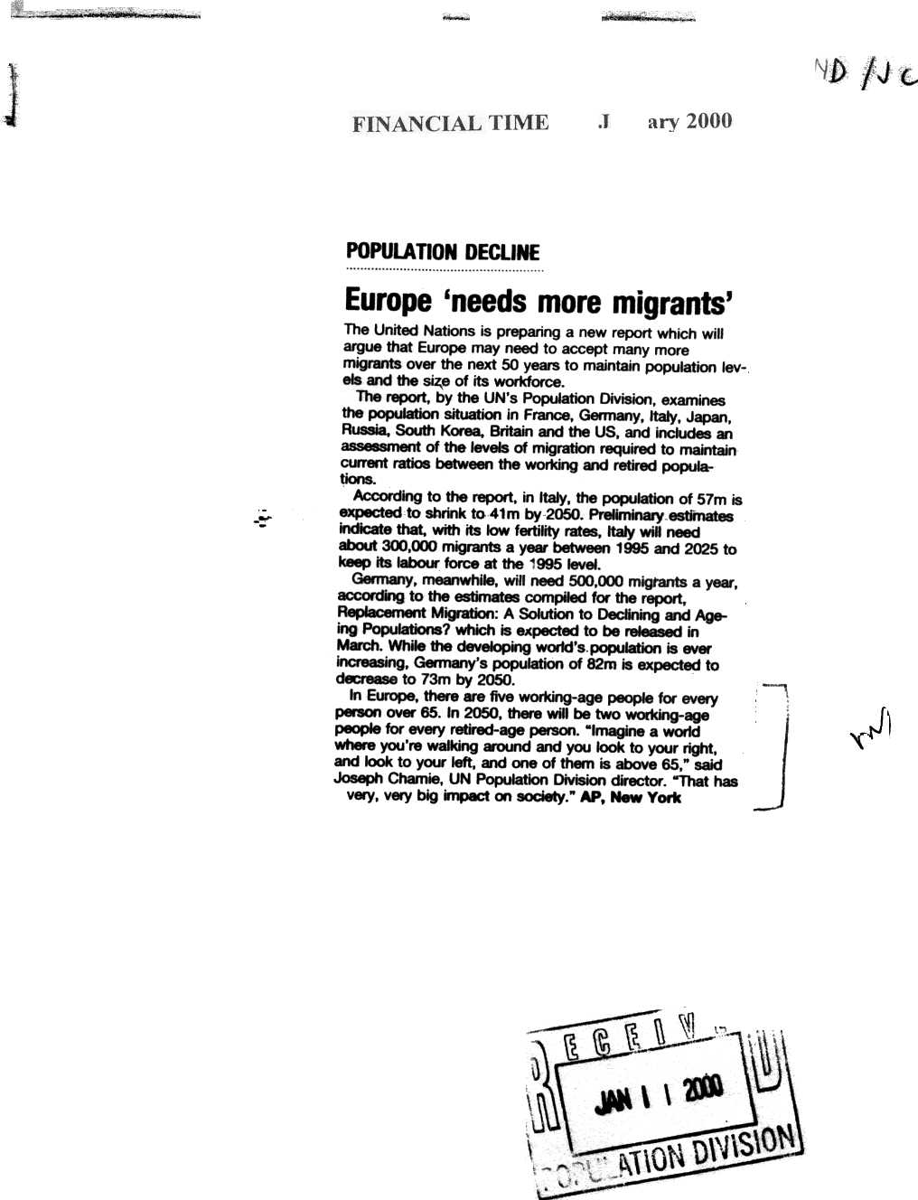

Slide 31
2010 US Census questions on “race”, “Hispanic”

Slide 32
Tragic choices; demographic determinism
Tragic choices on refugees: life or death?
True refugees not protected by govt of nationality
The special case of “boat people”
Rohingya (Myanmar)
Haiti
Cuba, including Mariel boatlift (US legislation complicates)
African migrants to EU (Lampedusa disaster)
Vietnam boat people (mostly ethnic Chinese?)
Tensions between Indonesia-Australia re: boat people

Slide 33
Demographic foresight: How right?
Fertility decline: accelerated by population policies
Low fertility co’s: nationalism, public pensions
Destabilizing: large demographic differentials
Lebanon: rise to power of Hezbollah
Israel/Palestinian conflict
India: large fertility disparities-north/south, Muslim/Hindu
Destabilizing: Persian Gulf guest-worker policies
shifted away from Arabs to Muslim non-Arabs
Redux: anti-foreigner neo-fascist movements Europe
Resistance to Turkey’s EU accession

Slide 34
How wrong? (What surprises?)
Mortality:
New epidemics: AIDS, SARS
Adult mortality rises in Russia
Fertility:
Rapidity of declines: in theocratic Iran, Mediterranean Europe
Longevity of very low fertility (Germany), one-child policy (China)
Handicaps for reproductive-age cohorts (jobs, income, housing)
Immigration:
Student, refugee visas as tools of terrorism (US: 9/11 attacks)
Globally: Elite support for guestworker programs, despite history
UK, Ireland, Sweden–no migration limits for new accession co’s
Notes:
Transformative effects of 1965 US reforms completely unanticipated, but continued

Slide 35
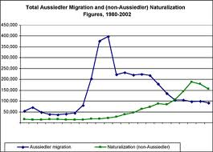

Slide 36
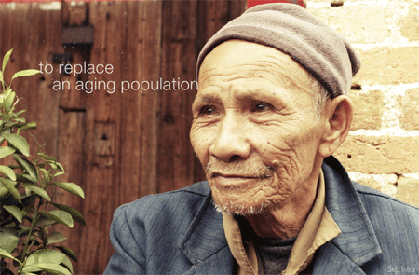
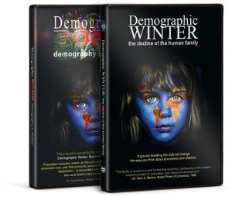
“Demographic Winter” film

Slide 37
Trailer from Demographic Winter video (2008)
“When there are many too many old people and not enough people to work and look after them which is what’s on the books now, mathematically speaking, you’re going to have economic collapse. There won’t be enough people to run the trains or pay the taxes.”
“It’s entirely possible that the French will disappear. There will no native born French that come from the traditional French population.”
“The only way you can sort of preserve the theory is to say well, certain kinds of human beings…are on the way to extinction.”
“What if the solutions were clear to Academia…but weren’t politically correct?”

Slide 38
Fear of decline redux, since around 1990
New pulse of books/videos, again with alarming titles
The Birth Dearth, 1989 (Ben Wattenberg, AEI)
The Empty Cradle: How Falling Birthrates Threaten World Prosperity and What to Do About It, 2004 (Philip Longman, New America)
What to Expect When No One’s Expecting: America’s Coming Demographic Disaster, 2013 (Jonathan V. Last, Weekly Standard)
Demographic Winter, 2008 (video produced by Population Research Institute, Washington)
Mostly by journalists, think-tanks, activists
Evocative images, influential in media

